Slide 1
Supporting the Sacrifice of our Nation’s Heroes throughout “Memorial May”
April 29th - May 30th 2021
Tim Suwandhaputra, AT&T Veterans EG ts703g@att.com (404) 394-7426
Kaylah Johnson, Retail Operations – FirstNet kj020u@att.com (512)431-7007
LaRyta Wiggins, FirstNet Marketing Event Sponsorships lj3008@att.com (214) 208-9890)
1
© 2020 AT&T Intellectual Property - AT&T Proprietary (Internal Use Only)

Slide 2
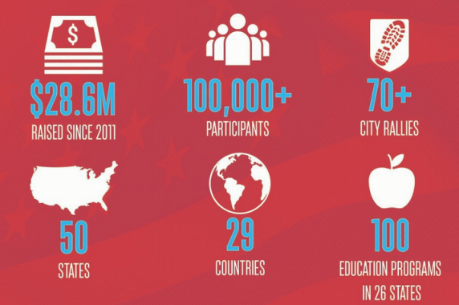
What is Carry the Load & “Memorial May”?
AT&T – FirstNet Sponsors CTL Nationwide in support of active duty & veteran military, law enforcement, firefighters, rescue personnel and their families.

Slide 3
Carry the Load Milestones & History

Slide 4
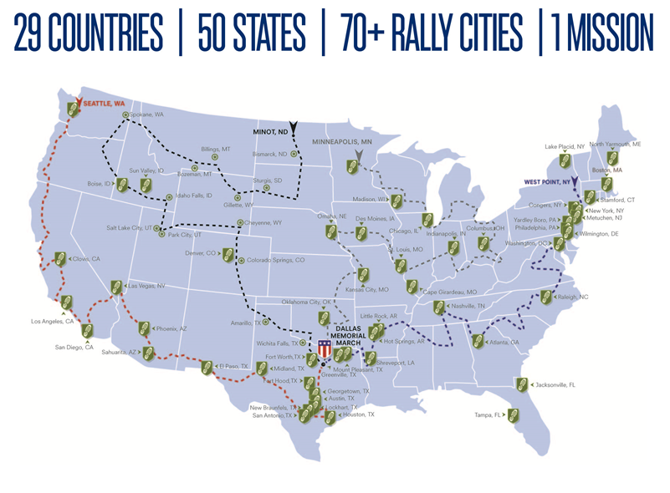
Four National Relay Routes – At a Glance

Slide 5
Making a Community Impact – April & May
West Coast: https://relay.carrytheload.org/routes/west-coast-route-guide-2021/
Mountain States: https://relay.carrytheload.org/routes/mountain-states-route-guide-2021/
Midwest: https://relay.carrytheload.org/routes/midwest-route-guide-2021/
East Coast: https://relay.carrytheload.org/routes/east-coast-route-guide-2021/
Teams & Chapters should begin planning to participate on the relay routes/ stops closest to them!

Slide 6
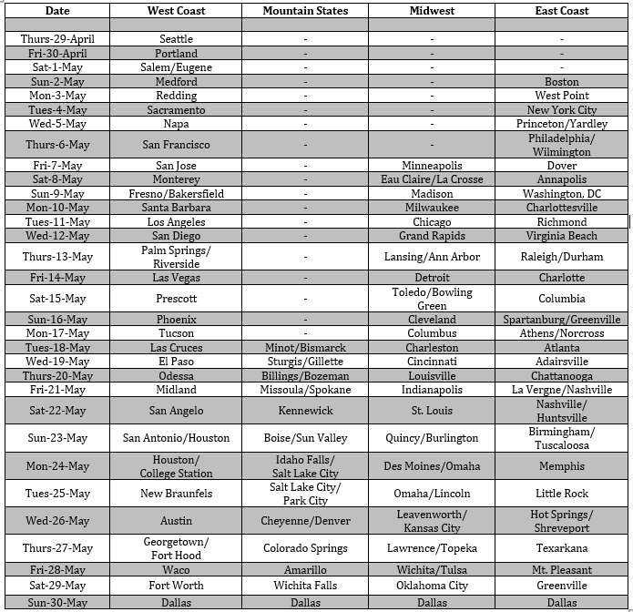
Major Cities & Dates throughout the Routes

Slide 7
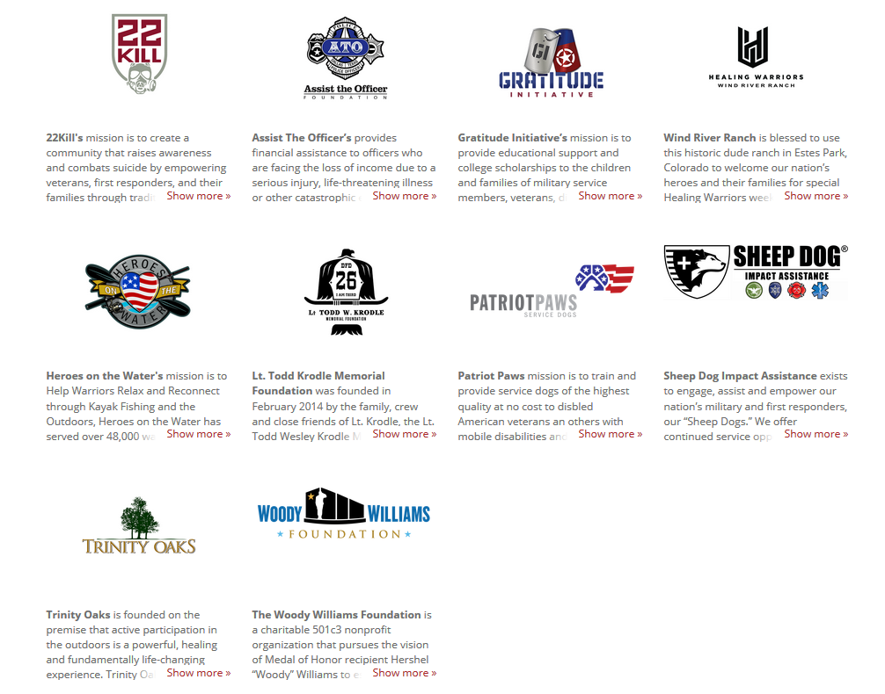
Where do Funds Raised for CTL go to? Working as a Force Multiplier…
Carry The Load’s Continuum of Care program is built upon a strategic collaboration among our corporate and non-profit partners.
The program raises awareness and funds to assist with issues facing our military, veterans, first responders & their families.
In addition to the healing our heroes experience by physically walking or volunteering with Carry The Load, peer-to-peer fundraising and corporate support strengthens nationwide services such as counseling, adaptive training, suicide prevention, equine therapy, service dogs, job placements, civilian transition, home improvements, hope for homeless veterans, care for burn victims, educational scholarships for children of the fallen, and many other healing services.
https://www.carrytheload.org/site/SPageServer/?pagename=continuum_of_care

Slide 8
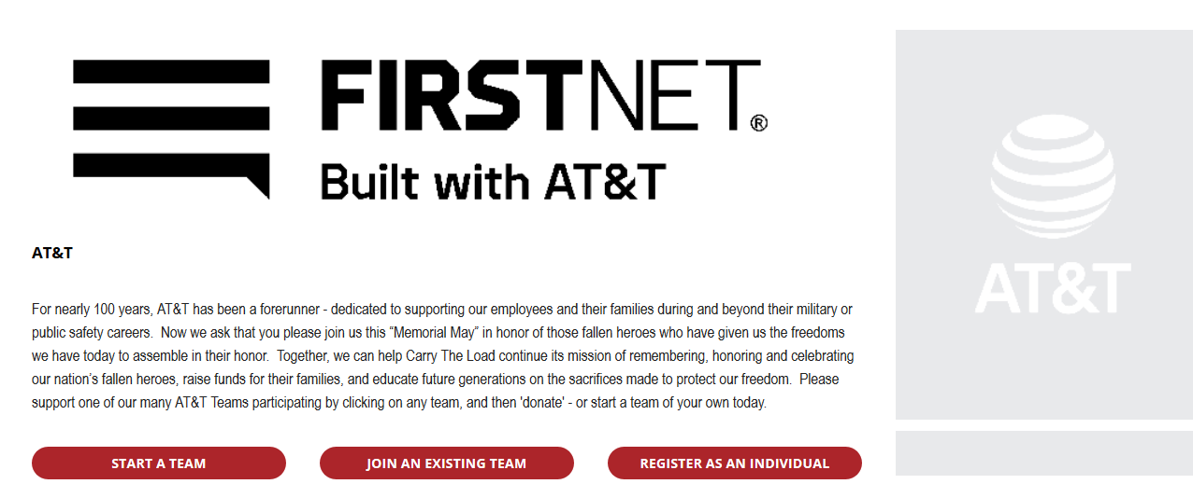
Start your Chapter’s CTL Team - Today!
Communicate & Recruit Participants (walkers) & donors to support an incredibly worthy cause!
Chapters can form one team to represent their chapter for members, friends & family to join!
Go to www.carrytheload.org/att
Click “Start a Team”
Name your team (Ensure Associated to “AT&T” as a Company)
Once established, share that team name with your chapter, so that they can sign up and plan towards April/May participation!

Slide 9
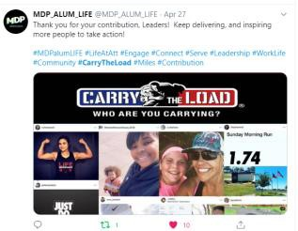
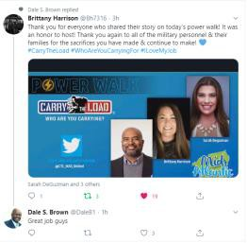
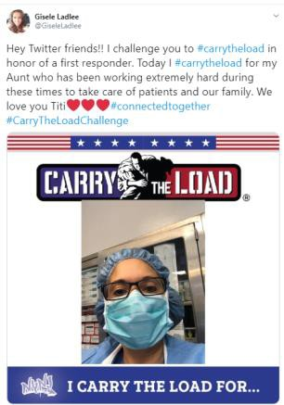
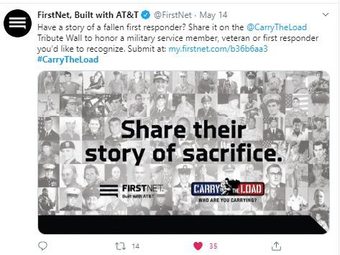
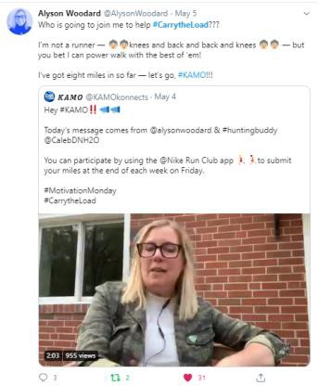
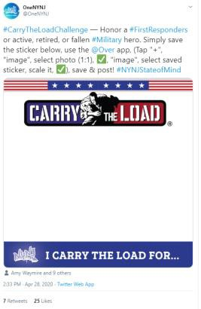
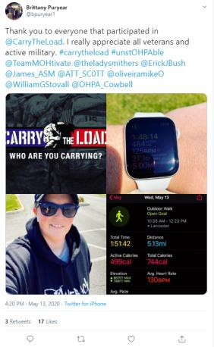
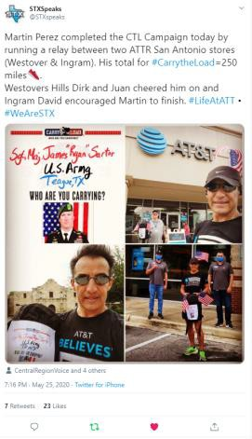
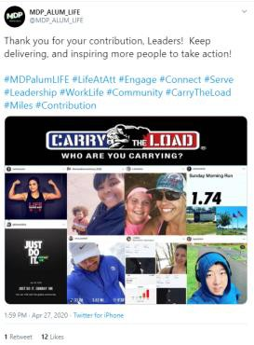
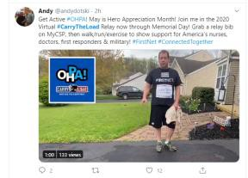
Retail Team Engagement – Social Media 2020!
Amazing engagement from AT&T Retail on Social Media alongside us!
Sharing Activities
Honoring Heroes
Broadcasting Watch Parties
Following the Relay

Slide 10
Resources – Posted to CTL Tspace!
Carry the Load Memorial May Playbook
Share Pictures and Ideas on the CTL Tspace!
https://tspace.web.att.com/communities/community/ATTVeterans/carrytheload

